Slide 1
SPY REINFORCEMENT LEARNING AGENT
BY TRAYVONIOUS PENDLETON

Slide 2
INTRODUCTION
PROGRAM: MS IN DATA SCIENCE, WGU
INTERESTS: MACHINE LEARNING,FINANCE,ALGORITHMIC TRADING

Slide 3
STATEMENT OF PROBLEM AND HYPOTHESIS
PROBLEM
Hypothesis
Can a reinforcement learning agent outperform a traditional buy-and-hold strategy when trading SPY?
Null: Historical data and technical indicators do not improve reinforcement learning agent performance
Alternate: Historical data and indicators significantly improve reinforcement learning agent trading outcomes

Slide 4
Data and Tools
Data
Tools
SPY OHLCV(Open,High,Low,Close and Volume)
Technical Indicators
Python
Tensorflow
Yfinace
Stable-Baselines3

Slide 5
Data Analysis Process
Data Collection: Yahoo Finance via yfinance
Feature Engineering: Adding technical indicators
Model Training: PPO reinforcement learning agent
Evaluation: Comparing agent performance to buy and hold

Slide 6

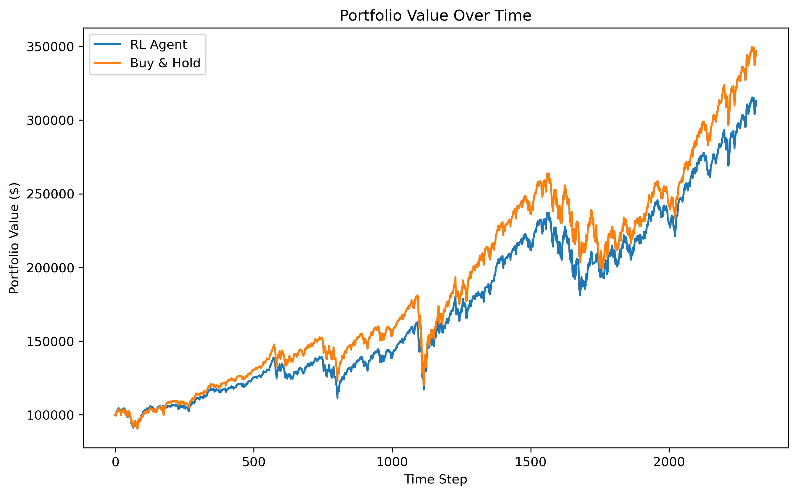
Key findings
Reinforcement Learning Agent outperformed buy and hold in cumulative returns
Higher Sharpe Ratio(risk-adjusted returns)
Portfolio value grew more steadily with Reinforcement Learning agent

Slide 7
Limitations
Model trained only on historical data
Simplified market environment
Real-world factors(slippage, fees) not fully simulated

Slide 8
Proposed Actions
Futher hyperparameter tuning
Expand feature set (add sentiment analysis,marco indicators)
Deploy model in paper trading before live trading

Slide 9
Expected Benefits
Improved trading strategy performance
Potential for higher returns and better risk management
Foundation for applying ML to real-world trading

Slide 10
Thank you

